Slide 1
Chapter 6: Physical Database Design and Performance
Modern Database Management
6th Edition
Jeffrey A. Hoffer, Mary B. Prescott, Fred R. McFadden

Slide 2
The Physical Design Stage of SDLC (figures 2.4, 2.5 revisited)
Project Identification
and Selection
Purpose –develop technology specs
Deliverable – pgm/data structures, technology purchases, organization redesigns
Project Initiation
and Planning
Analysis
Logical Design
Physical Design
Database activity –
physical database design
Implementation
Maintenance

Slide 3
Physical Database Design
Purpose- translate the logical description of data into the technical specifications for storing and retrieving data
Goal - create a design for storing data that will provide adequate performance and insure database integrity, security and recoverability

Slide 4
Physical Database Design

Slide 5
Physical Design Process
Inputs
Decisions
Normalized relations
Volume estimates
Attribute definitions
Response time expectations
Data security needs
Backup/recovery needs
Integrity expectations
DBMS technology used
Attribute data types
Physical record descriptions (doesn’t always match logical design)
File organizations
Indexes and database architectures
Query optimization
Leads to

Slide 6
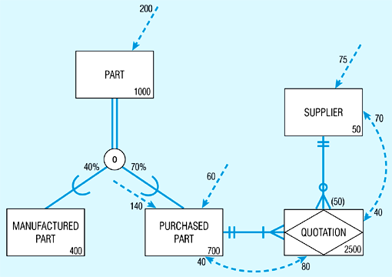
Figure 6.1 - Composite usage map
(Pine Valley Furniture Company)

Slide 7
Figure 6.1 - Composite usage map
(Pine Valley Furniture Company)
Data volumes

Slide 8
Figure 6.1 - Composite usage map
(Pine Valley Furniture Company)
Access Frequencies (per hour)

Slide 9
Figure 6.1 - Composite usage map
(Pine Valley Furniture Company)
Usage analysis:
200 purchased parts accessed per hour ➔
80 quotations accessed from these 200 purchased part accesses ➔
70 suppliers accessed from these 80 quotation accesses

Slide 10
Figure 6.1 - Composite usage map
(Pine Valley Furniture Company)
Usage analysis:
75 suppliers accessed per hour ➔
40 quotations accessed from these 75 supplier accesses ➔
40 purchased parts accessed from these 40 quotation accesses

Slide 11
Designing Fields
Field: smallest unit of data in database
Field design
Choosing data type
Coding, compression, encryption
Controlling data integrity

Slide 12
Choosing Data Types
CHAR – fixed-length character
VARCHAR2 – variable-length character (memo)
LONG – large number
NUMBER – positive/negative number
DATE – actual date
BLOB – binary large object (good for graphics, sound clips, etc.)

Slide 13
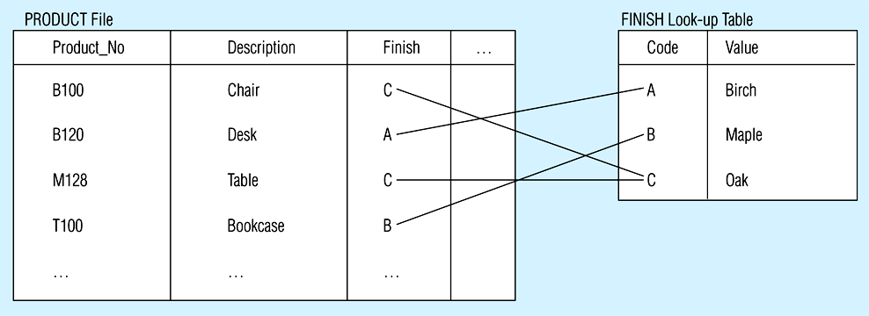
Figure 6.2
Example code-look-up table (Pine Valley Furniture Company)
Code saves space, but costs an additional lookup to obtain actual value.

Slide 14
Field Data Integrity
Default value - assumed value if no explicit value
Range control – allowable value limitations (constraints or validation rules)
Null value control – allowing or prohibiting empty fields
Referential integrity – range control (and null value allowances) for foreign-key to primary-key match-ups

Slide 15
Handling Missing Data
Substitute an estimate of the missing value (e.g. using a formula)
Construct a report listing missing values
In programs, ignore missing data unless the value is significant
Triggers can be used to perform these operations

Slide 16
Physical Records
Physical Record: A group of fields stored in adjacent memory locations and retrieved together as a unit
Page: The amount of data read or written in one I/O operation
Blocking Factor: The number of physical records per page

Slide 17
Denormalization
Transforming normalized relations into unnormalized physical record specifications
Benefits:
Can improve performance (speed) be reducing number of table lookups (i.e reduce number of necessary join queries)
Costs (due to data duplication)
Wasted storage space
Data integrity/consistency threats
Common denormalization opportunities
One-to-one relationship (Fig 6.3)
Many-to-many relationship with attributes (Fig. 6.4)
Reference data (1:N relationship where 1-side has data not used in any other relationship) (Fig. 6.5)

Slide 19
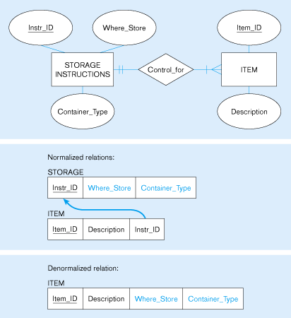
Fig 6.5 –
A possible denormalization situation:
reference data
Extra table access required
Data duplication

Slide 21
Partitioning
Horizontal Partitioning: Distributing the rows of a table into several separate files
Useful for situations where different users need access to different rows
Three types: Key Range Partitioning, Hash Partitioning, or Composite Partitioning
Vertical Partitioning: Distributing the columns of a table into several separate files
Useful for situations where different users need access to different columns
The primary key must be repeated in each file
Combinations of Horizontal and Vertical
Partitions often correspond with User Schemas (user views)

Slide 22
Partitioning
Advantages of Partitioning:
Records used together are grouped together
Each partition can be optimized for performance
Security, recovery
Partitions stored on different disks: contention
Take advantage of parallel processing capability
Disadvantages of Partitioning:
Slow retrievals across partitions
Complexity

Slide 23
Data Replication
Purposely storing the same data in multiple locations of the database
Improves performance by allowing multiple users to access the same data at the same time with minimum contention
Sacrifices data integrity due to data duplication
Best for data that is not updated often

Slide 24
Designing Physical Files
Physical File:
A named portion of secondary memory allocated for the purpose of storing physical records
Constructs to link two pieces of data:
Sequential storage.
Pointers.
File Organization:
How the files are arranged on the disk.
Access Method:
How the data can be retrieved based on the file organization.

Slide 25
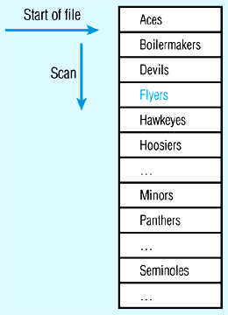
Figure 6-7 (a) Sequential file organization
1
2
Records of the file are stored in sequence by the primary key field values.
If sorted – every insert or delete requires resort
If not sorted
Average time to find desired record = n/2.
n

Slide 26
Indexed File Organizations
Index – a separate table that contains organization of records for quick retrieval
Primary keys are automatically indexed
Oracle has a CREATE INDEX operation, and MS ACCESS allows indexes to be created for most field types
Indexing approaches:
B-tree index, Fig. 6-7b
Bitmap index, Fig. 6-8
Hash Index, Fig. 6-7c
Join Index, Fig 6-9

Slide 27
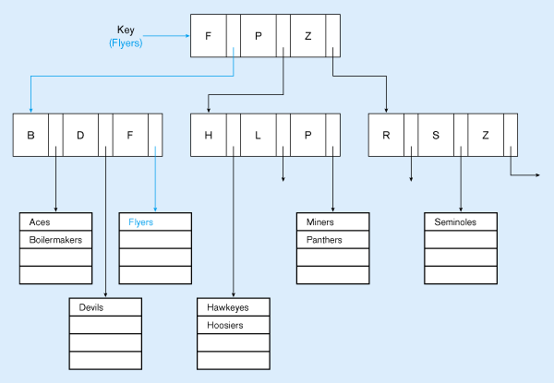
Fig. 6-7b – B-tree index
Leaves of the tree are all at same level →
consistent access time
uses a tree search
Average time to find desired record = depth of the tree

Slide 28
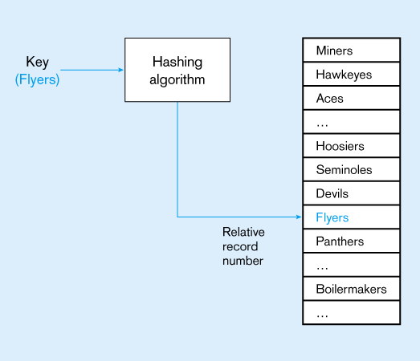
Fig 6-7c
Hashed file or index organization
Hash algorithm
Usually uses division-remainder to determine record position. Records with same position are grouped in lists.

Slide 29
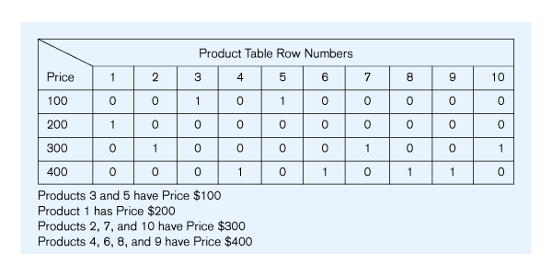
Fig 6-8
Bitmap index index organization
Bitmap saves on space requirements
Rows - possible values of the attribute
Columns - table rows
Bit indicates whether the attribute of a row has the values

Slide 30
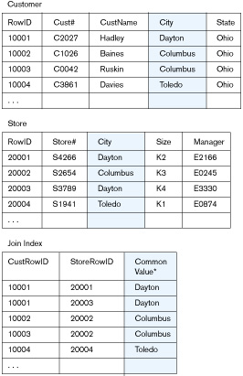
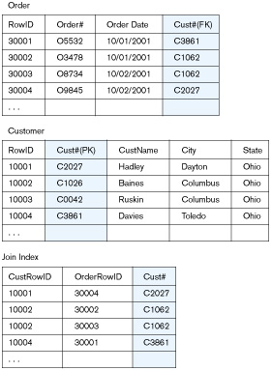
Fig 6-9 Join Index – speeds up join operations

Slide 31
Clustering Files
In some relational DBMSs, related records from different tables can be stored together in the same disk area
Useful for improving performance of join operations
Primary key records of the main table are stored adjacent to associated foreign key records of the dependent table
e.g. Oracle has a CREATE CLUSTER command

Slide 32
Rules for Using Indexes
1. Use on larger tables
2. Index the primary key of each table
3. Index search fields (fields frequently in WHERE clause)
4. Fields in SQL ORDER BY and GROUP BY commands
5. When there are >100 values but not when there are <30 values

Slide 33
Rules for Using Indexes
6. DBMS may have limit on number of indexes per table and number of bytes per indexed field(s)
7. Null values will not be referenced from an index
8. Use indexes heavily for non-volatile databases; limit the use of indexes for volatile databases
Why? Because modifications (e.g. inserts, deletes) require updates to occur in index files

